Slide 1
Homework 5 Analysis
Olivier McNicoll
**Problems with Matlab on VM vs actual machine caused me to struggle porting data. As a result, most of the analysis is done in Python, except for the Magx vs MagY calculations. The matlab script for that is called correctmag.m. The rest of the analysis is all in analyze.py, which manipulates the data in all different ways and has a bunch of different plots at the bottom.

Slide 2
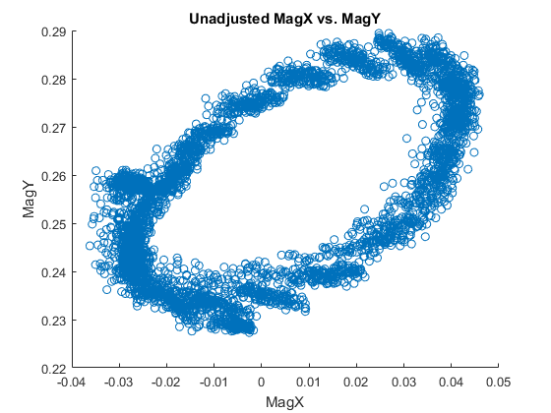
The MagX vs MagY data we logged by going around the circle in front of Ruggles five times. The noise seen on the noise seen on the left side is most likely due to the stopping and starting position. You can also see slight groupings, which are most clear around the top and bottom. I think these might simply be due to the frequency of the data points.

Slide 3
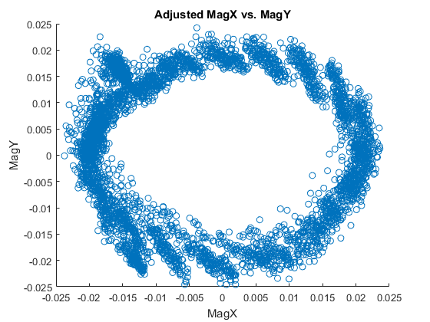
After fitting an ellipse to the prior data, I centered the data to 0,0, rotated the ellipse by -.5104 radians, and then resized the x coordinates such that they are the same scale as the y coordinates. This resulted in these adjusted magx vs magy readings, and gave me a transformation for later data.

Slide 4
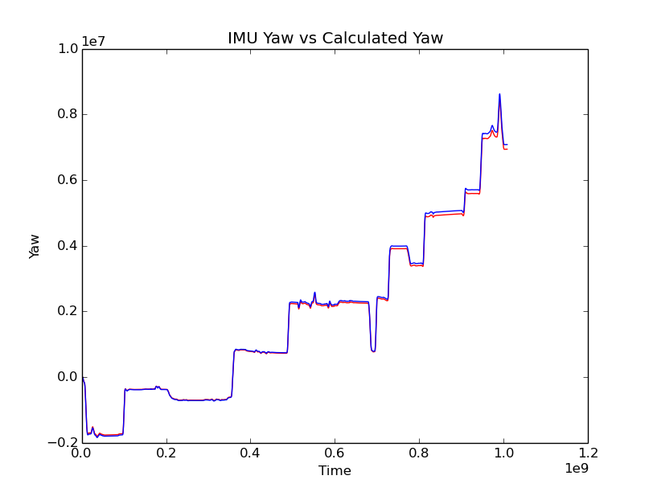
IMU Yaw vs. Calculated Yaw
As can be clearly seen, the IMU yaw value is incredibly similar to the calculated yaw value. I think this may be because the IMU gets it's yaw value but integrating values itself. Therefore, by integrating the same data the IMU probably does, I achieve almost identical yaw.

Slide 5
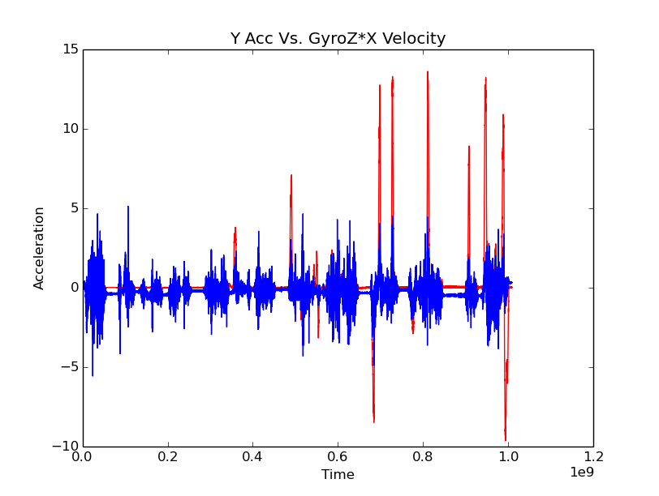
Y Acceleration vs. w*X velocity
Not completely confident on this figure. The blue represents the y acceleration taken from the IMU, and it seems to be much more stable then the GyroZ*X velocity. They do seem to agree sometimes, particularly on larger accelerations, however the calculated acceleration is significantly higher than the y acceleration. I'm guessing the differences and lack of unity between the two is due to both inteference as well as placement of the IMU. The IMU was places on the top of the car, and therefore was definitely not perfectly level. This causes the 9.8m/s2 of gravity to be distributed weirdly across the three axis depending on the actual placement of the IMU.

Slide 6
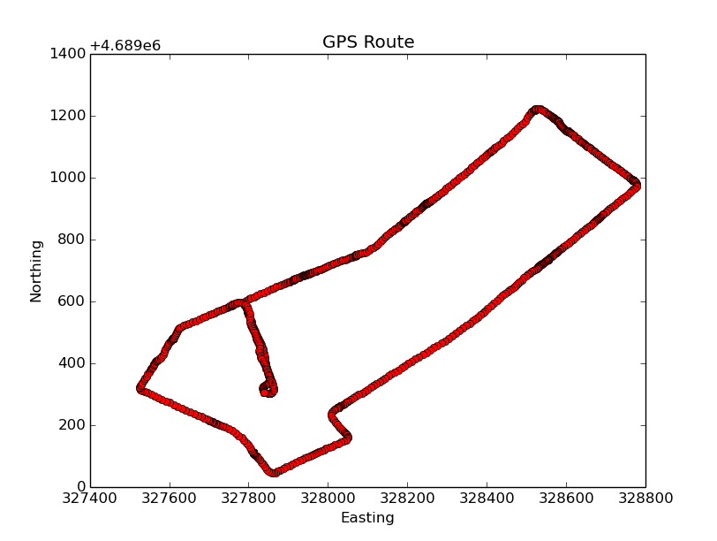
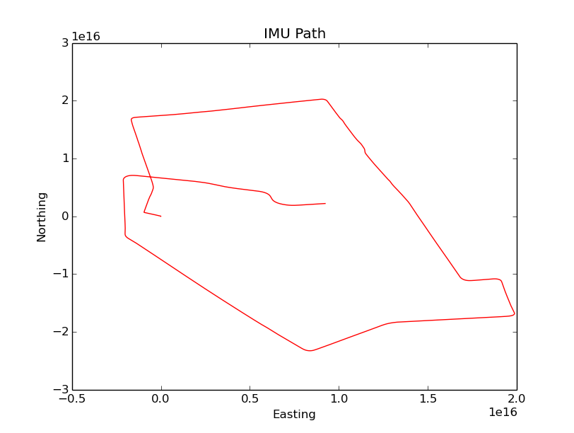
GPS Path vs IMU Path

Slide 7
Analysis of Paths
I used the transformations from the circle in slides 2/3 in order to normalize the IMU path, however it still came out much different. The angle of the path is off, and the distances are nowhere near what they should be. Again, this is probably due to changes in elevation and slope, which changed the acceleration in unwanted and unexpected ways, since we were just assuming a 2d field.

